Slide 1

YOU ARE WELCOME
TO WATCH
EKTA GROUP
PROFILE

Slide 2
EKTA ENTERPRISES
Started Business in 2006
EKTA provides the high-quality welding & brazing products that are second to none. It is our commitment to customer service that sets us apart from everyone else. We have a worldwide network that provides us the strength of sourcing best quality products from best suppliers all over the world with highly competitive prices.
Our customers face ever increasing competitive pressures and volatile business climates. Since product cost and on-time delivery are vital to success, many customers have learned that partnering with EKTA as their importer & exporter gives them the competitive advantage, they need to reduce cost and improve their bottom line. Our customers, large or small, count on our ability to deliver products, information, and assistance in a timely manner. At EKTA, we are very responsive to our customer needs, which save your time and confusion, and assure the personal attention you deserve. We offer the flexibility to provide our customers with the product from they need to meet their unique specifications.
Professional competence, combined with high-quality products, has led us to our present position as one of the leading importers & exporter of welding & brazing Products in the Indian market. Owing to our efficient sales organization we have become exclusive world-renowned importer & exporter of welding & brazing consumables. We are committed to utilizing the latest advancements in technology to enhance our service, sales and distribution efforts.

Slide 3


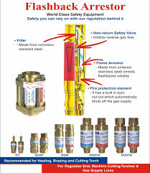
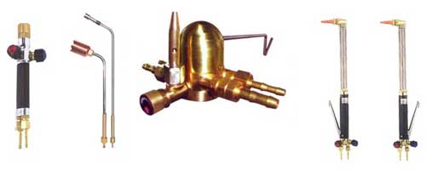
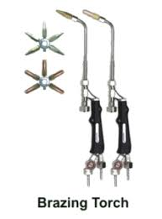
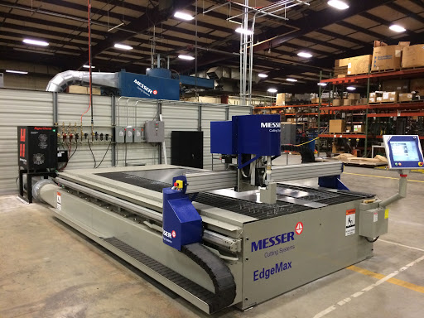
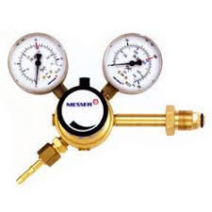
Authorized Distributor

Slide 4


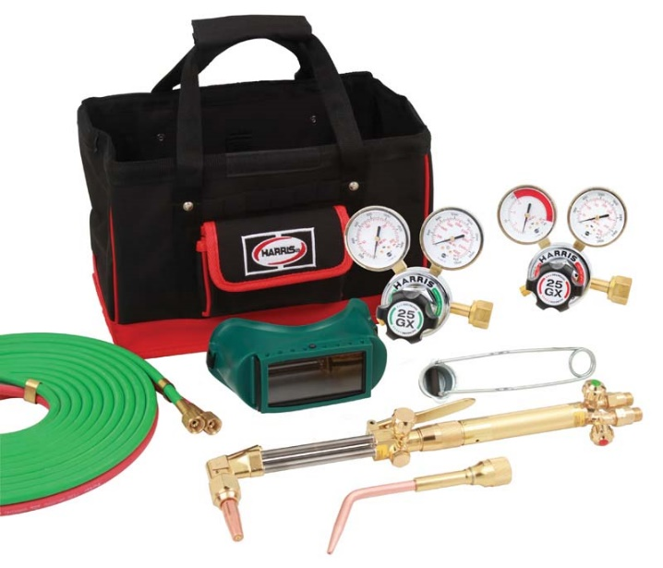

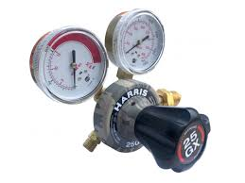
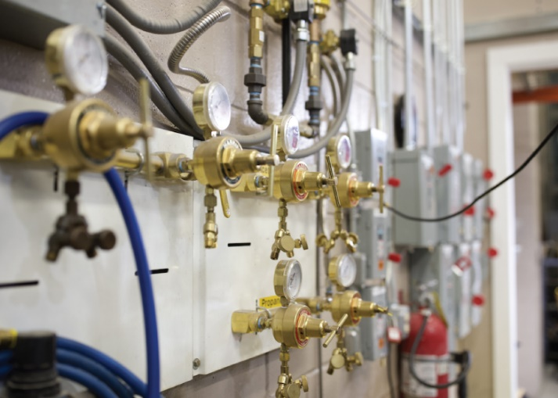
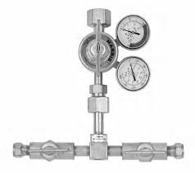
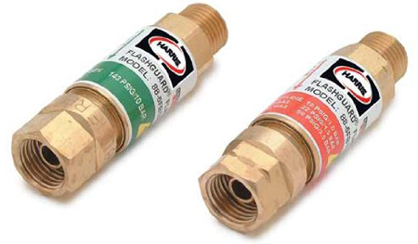
AUTHORISED DEALER

Slide 5

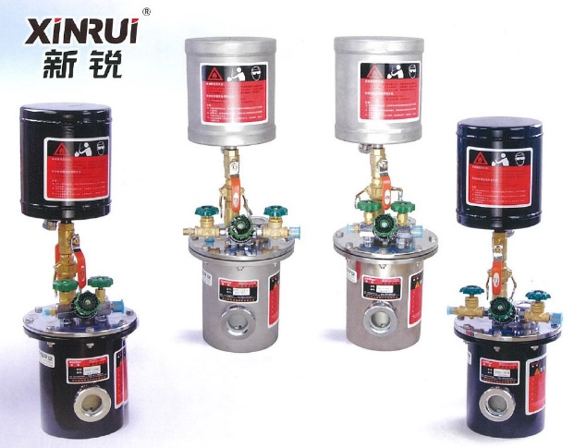
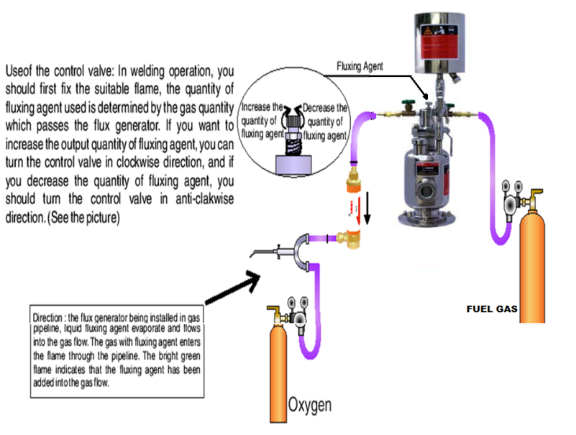
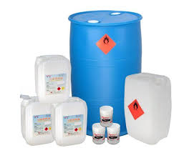
Authorized Distributor

Slide 6
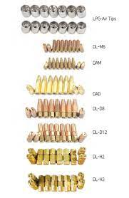
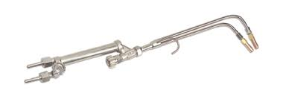
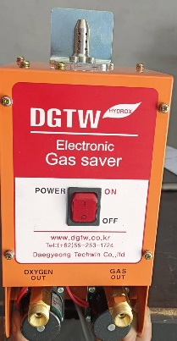
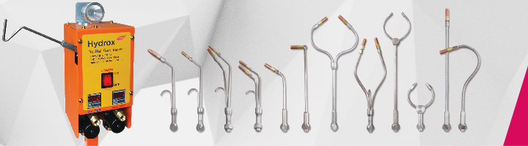
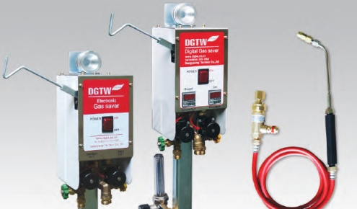
AUTHORISED DEALER
HYDROX (KORIA)

Slide 7


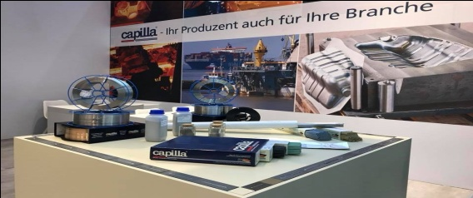
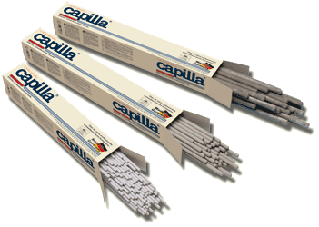

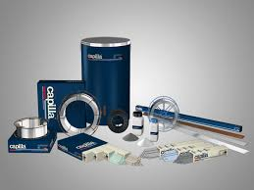
Authorized Distributor

Slide 8

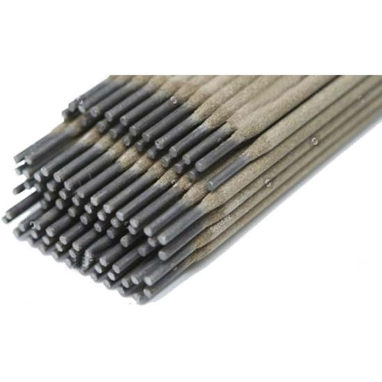
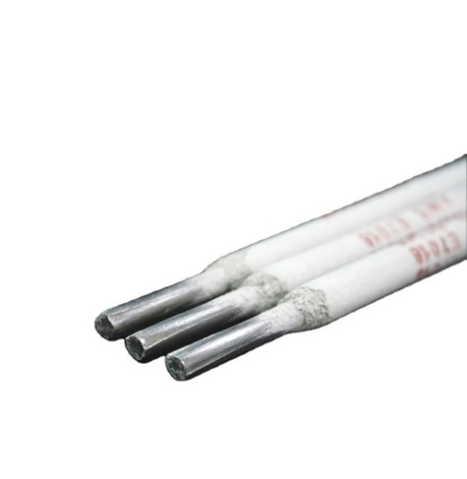
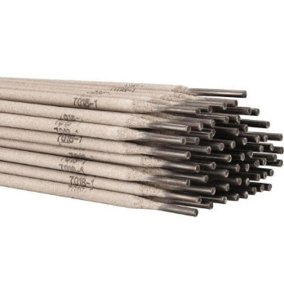
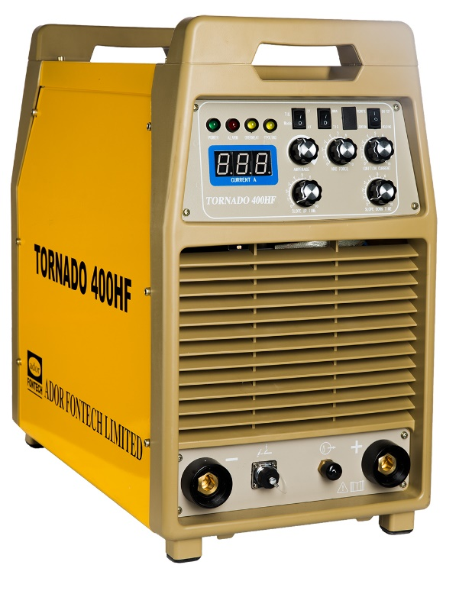
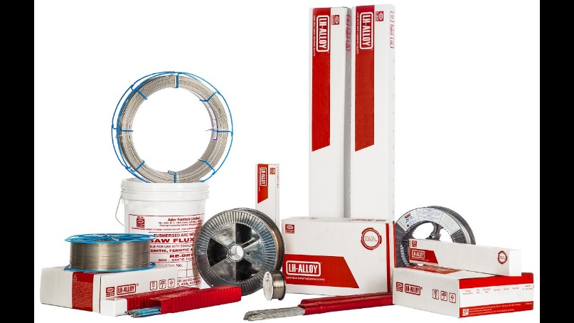
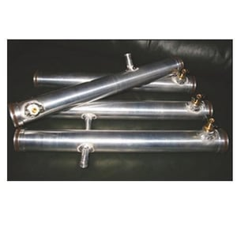
AUTHORISED DEALER

Slide 9

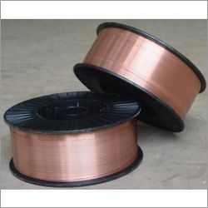
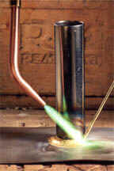
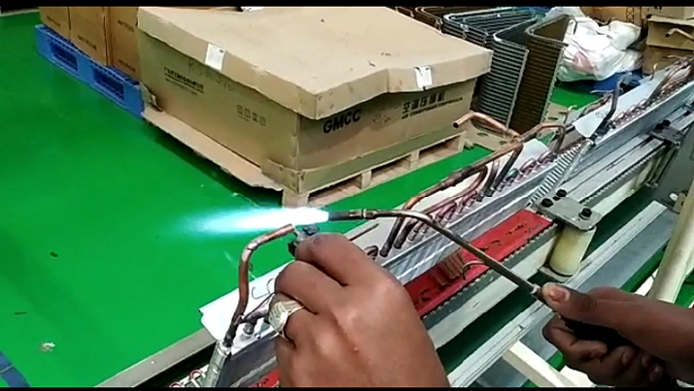
OUR SERVICES IN CONSUMABLE
Our imported consumable products are unrivalled in quality and easy on pocket. Copper Phosphorus Alloys, MIG Brazing Wires, Brass Brazing Rod, Brazing Flux along with a host of various other products we deal in are excellent in quality and high on durability because they have been produced using STATE-OF-THE-ART.

Slide 10
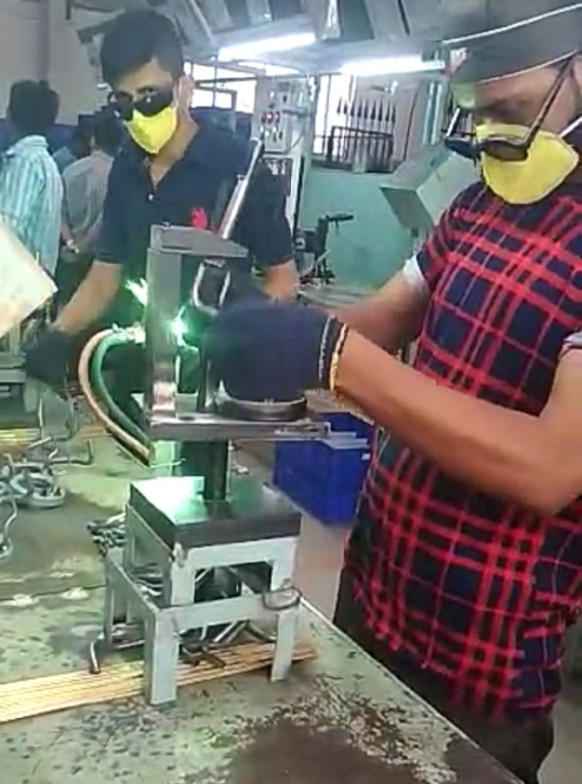
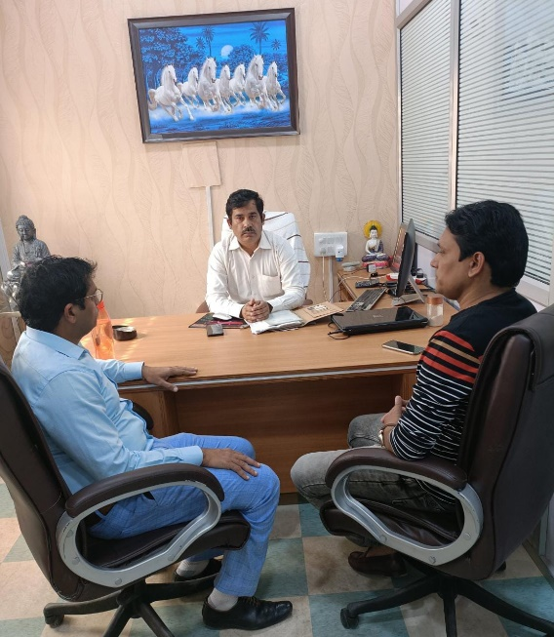
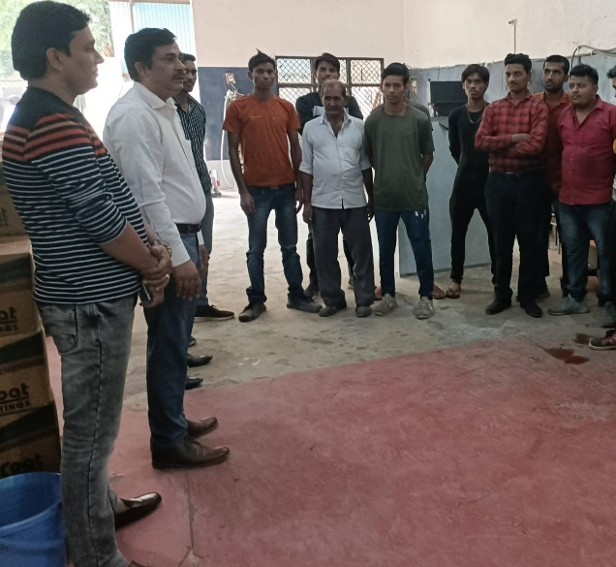
STRENGTH OF EKTA GROUP
1. Ekta Group have a team of experienced Engineers, Braziers,
Welders, qualified & experienced sales team.
2. Team well knows which product will used for better result?
3. We provide technical and product training from our principal to
our sales and technical team.

Slide 11
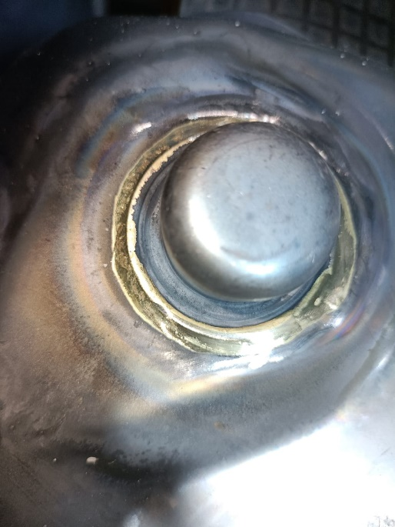
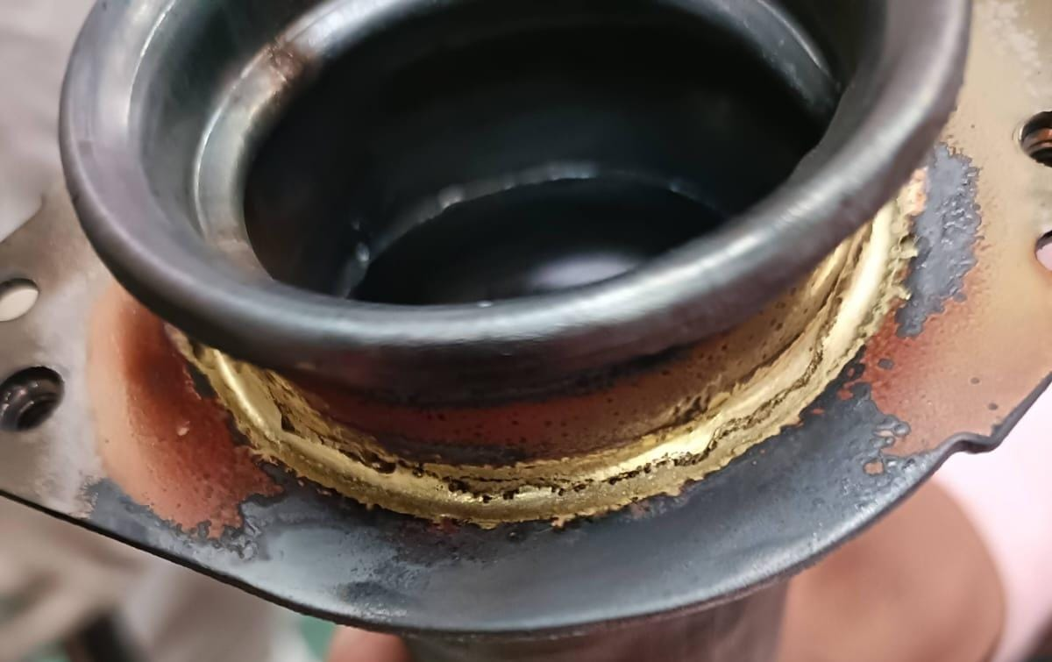
Case Study
1. Our sales team regular visited to our clients and updated
and innovated products according to customer need.
2. He check and insure component description.
3. Checked gas pressure is proper as per component requirement.
4. Checked brazing product as per component requirement.
5. Checked rod size as per component filler gap.
6. If found any problem than suggest better solution.

Slide 12

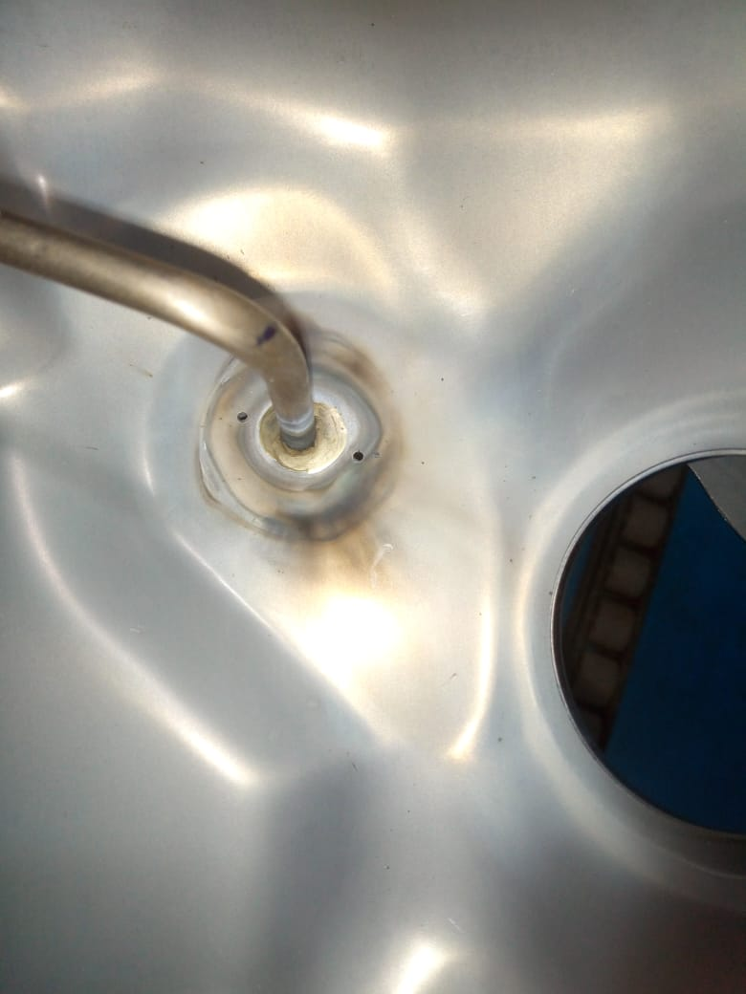
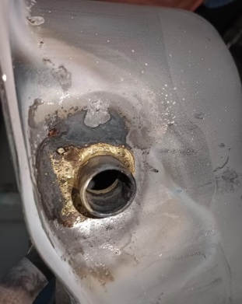
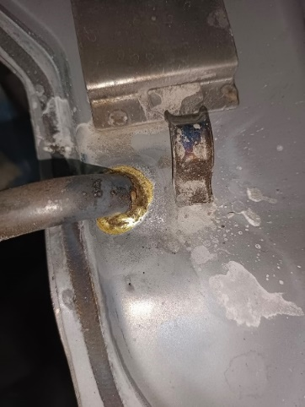
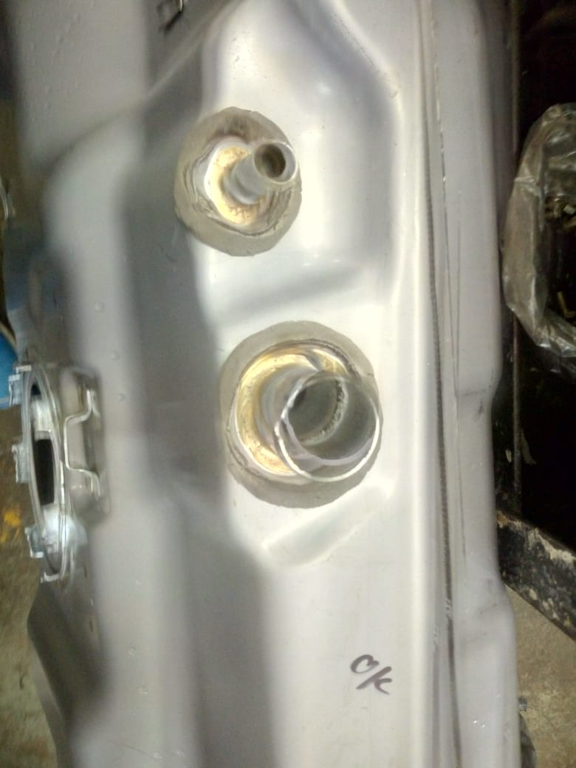

Solution
1. Our engineer team suggest solution according to component.
2. Which chemical composition will need?
3. Which brazing product will better?
4. What gas pressure will need?
5. What timing should need for component brazing or complete?
EKTA ENTERPRISES HAS COMPLETE SOLUTION

Slide 13

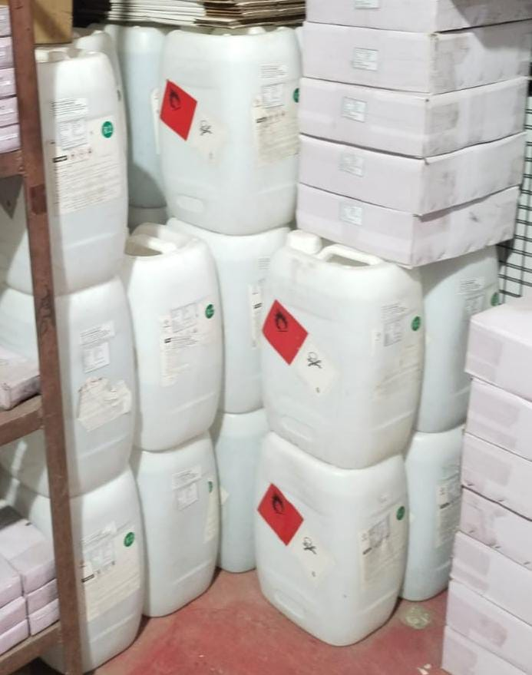
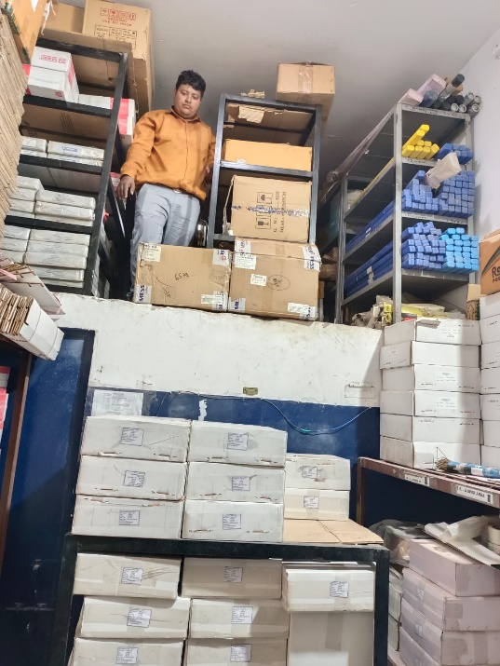
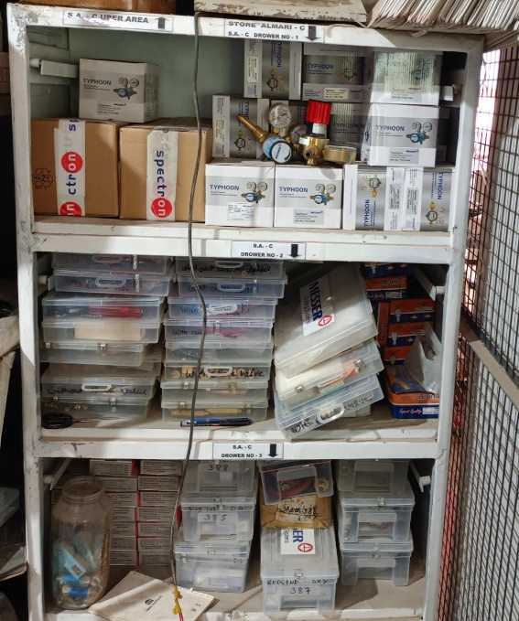
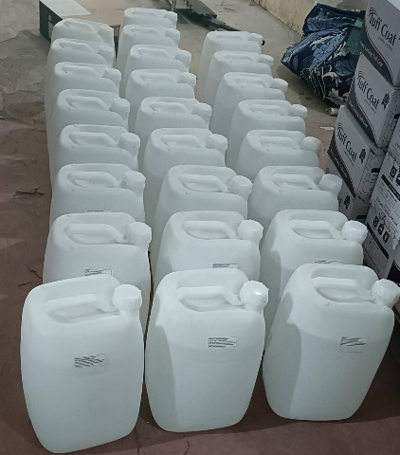
Supply and Store
Import, planning, stock material as per customer requirement.
We tried and insure we give best service and supply.

Slide 14

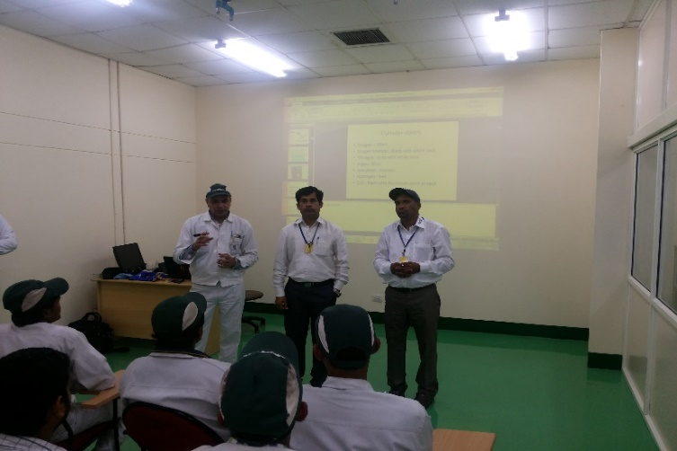
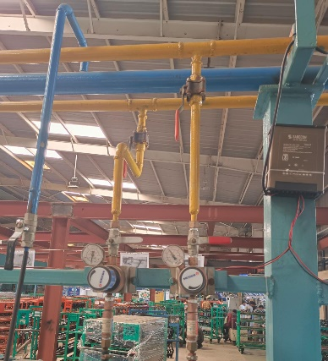
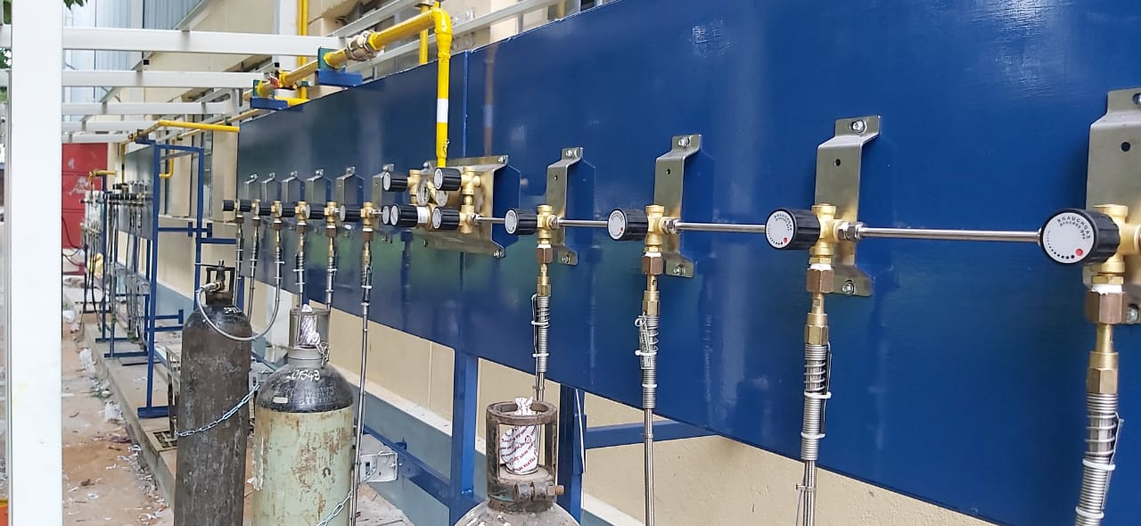
Strength
We are providing Safety training in industries and suggest cost
Saving and innovative products as per customer requirement.

Slide 15













Our Major Clients

Slide 16








Our Major Clients

Slide 17








Our Major Clients

Slide 18
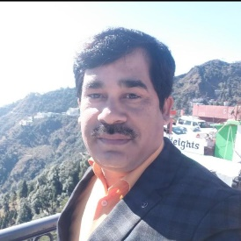
Thanks for your attention
Regards
Mr. Rajesh Nehra (Director)
EKTA GROUP

